Slide 1
Credit Risk Analysis
Shasha. L

Slide 2
Data Cleaning

Slide 3
Objective
Why clients default on their July statement ?
What is the best model for predicting their July Payment Status ?

Slide 4
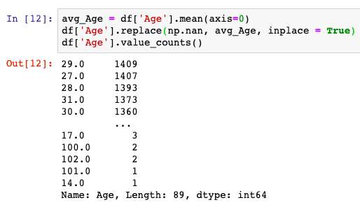
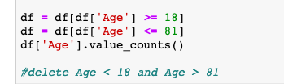
Assumption - Age
Replace NA for age by mean
Minimum age to get a credit card 18 and life expectancy 81.7 (based on Statistics Canada), so we assume maximum age 81

Slide 5
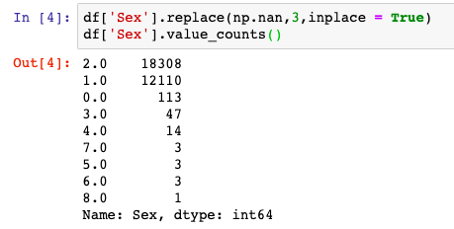
Redefine Value Labels - Sex
Male = 1
Female = 2
Unknown = 3

Slide 6
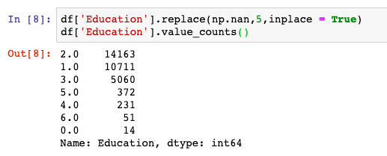
Redefine Value Labels - Education
Master’s degree & Doctoral degree = 1
Bachelor‘s degree = 2
High school’s degree = 3
Others = 4
Unknown = 5

Slide 7
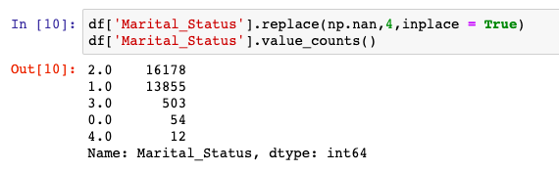
Redefine Value Labels – Marital Status
Married =1
Single = 2
Others = 3
Unknown = 4

Slide 8






Redefine Value Labels – Repay Status
Paid on time properly = 0
Payment delayed for n month already = n

Slide 9

Data Standardization
The percentage of previous payment = $\frac{\text{previous} \text{payment}}{\text{statement} \text{balance}}$
The percentage of statement balance = $\frac{\text{statement} \text{balance}}{\text{the} \text{limit} \text{of} \text{credit}}$

Slide 10
Data Analysis

Slide 11
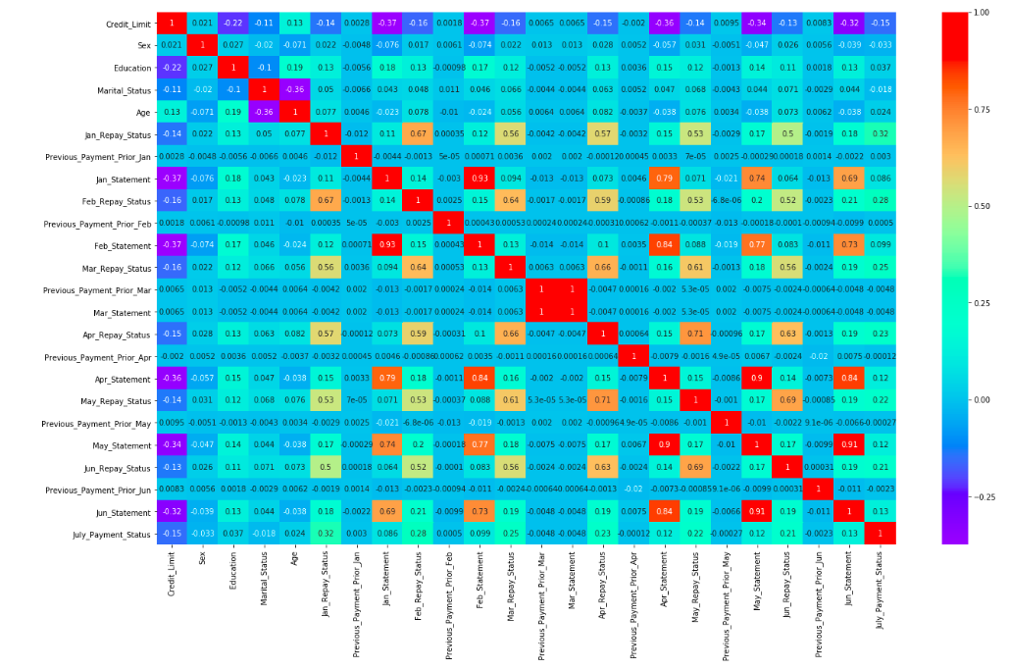
Correlation

Slide 12
Age
There is a higher default risk before the age of 20,possibly because they do not have a stable salary.
From 20 to 54 the default risk keep stable.
After 54, the default risk gradually increase. This may due to some of the larger expense such as suffering from some disease

Slide 13
Credit Limit
Credit Limit between 0 to 10000 has a higher default risk
Credit Limit

Slide 14
Sex
Average
Man have a higher default risk than women

Slide 15
Education
Average
A lower degree may have a higher default risk, but does not have a significant impact on group 1, 2, 3

Slide 16
Marital Status
Marital Status does not have a significant impact on payment default
Average

Slide 17
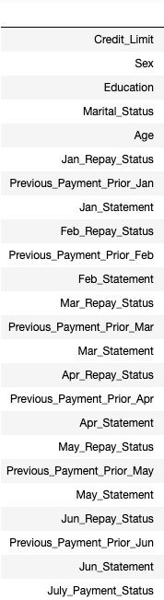
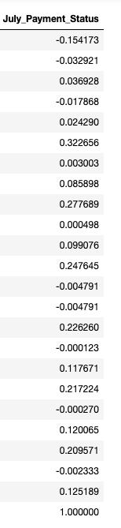
Correlation
Corr > 0.2 ----- a significant relationship

Slide 18
Modeling

Slide 19
Modeling-Assupmtion
X: Jan_Repay_Status, Feb_Repay_Status, Mar_Repay_Status, Apr_Repay_Status, May_Repay_Status, Jun_Repay_Status
Y: July_Payment_Status
Drop NAN for X
20% test data

Slide 20
Modeling - Classification
Logistic Regression
K-Nearest Neighbors
Randomforest
SVM

Slide 21
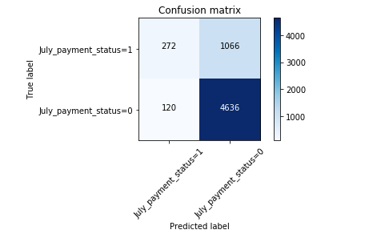
Modeling-Logistic Regression

Slide 22
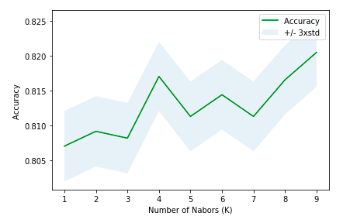
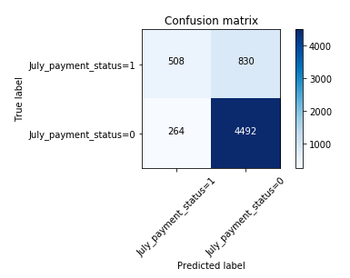
Modeling-K-Nearest Neighbor

Slide 23
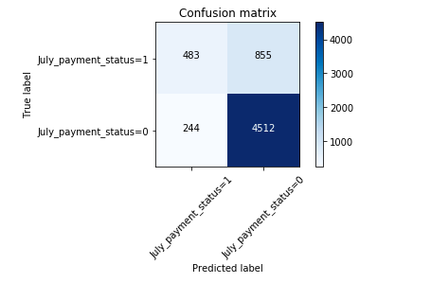
Modeling-Randomforest

Slide 24
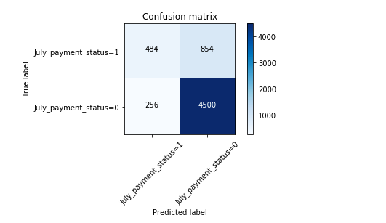
Modeling-SVM

Slide 25
Conclusion
Among the algorithms used, K-Nearest Neighbors (K=9) gave a higher accuracy, which about 82%.
However, the model only uses high-correlation variables to train the model, we still can improve our model through other feature variables.

